Slide 1

Enabling DevOps Adoption with Electric Cloud
Rohit Jainendra (RJ)
Chief Products Officer
Notes:
Hello there! Thank you for attending DevOps Enterprise 2015. What a wonderful start this morning, and look forward to tons more learning and collaboration over the next three days.
I‘m Rohit Jainendra, I go by RJ and I‘m the Chief Product Officer at Electric Cloud.
(SHOW OF HANDS – how many of you are EC customers?)
Our mission at Electric Cloud is to help our customers deliver better software faster, and we‘re really happy to be able to get a lot of like minded people together at this conference to advance DevOps practices in our organizations.

Slide 2
CULTURE
AUTOMATION
MEASUREMENT
SHARING
Notes:
Succeeding at DevOps is a multi-faceted problem and a significant portion of it has to do with culture and processes. Back in 2010, John Willis and Damon Edwards coined the acronym CAMS as the core values of the DevOps movement.
A DevOps culture is about breaking down barriers between teams fostering healthy interaction between groups instead of wasting time in ticketing queues or writing copious documentation for the person sitting right next to you.
Automation is about using the right tools to eliminate mundane manual work to prevent defects, create consistency and enable self-service.
Need to be able to measure your progress towards your goals in an objective way. With the right measurements in place, decisions are made based on data rather than instincts.
We all realize the importance of sharing, that’s why we are here at the conference to learn from each other and this is very true within successful DevOps teams as well.
At Electric Cloud, we help customers improve their software delivery by automating and accelerating the delivery process once developers have written the code.

Slide 3

































AUTOMATE & ACCELERATE DELIVERY
BUILD/TEST
FLEXIBLE AND SCALABLE AUTOMATION FOR DEV AND QA
DEPLOY
ANY APP. ANY VERSION. ANYWHERE. ANYTIME.
OTHER
ORCHESTRATE ANY TOOLCHAIN OR PROCESS. CLI, RESK, SOAP, HTTP, API AND SDK
DEV
OPS
ElectricAccelerator
ElectricFlow
DEVOPS AUTOMATION PLATFORM
SHARED CONTROL | SHARED VISIBILITY | SHARED RESOURCES
EXTENSIBLE
SCALABLE
SECURE
FLEXIBLE
TRANSPARENT
HYBRID CLOUD
Plugs right in to
your existing tools
Notes:
Our ElectricFlow product is an automation platform to fully automate the delivery process from developer check-in, through testing, with deployment into production or release to manufacturing if you are building software systems.
ElectricFlow was previously known as ElectricCommander and has all the capabilities, and aside from a better UI is a seamless upgrade.
ElectricAccelerator provides build and test acceleration for customers to reduce builds and tests from hours down to minutes. This is a powerful enabler to get fast feedback to the team.

Slide 4
WHAT’S NEEDED FOR ENTERPRISE CD
Artifact
Repository
Build/Test Automation
Deployment
Automation
Pipeline & Release Orchestration
Monitoring
Provisioning
Tool Integrations
Configuration
4
Notes:
So you may be thinking, hey my team already uses Chef or Puppet for provisioning and configuring servers. Do I need anything more? I hope during this session you’ll see how these tools fit into the overall process of delivering software.

Slide 5

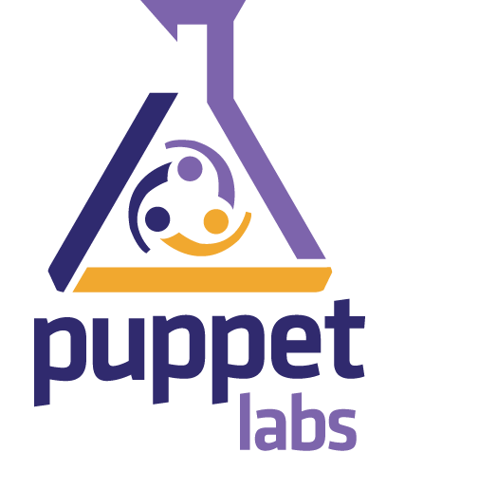

DEVOPS TOOL CATEGORIES
DevOps READY
DevOps ENABLED
DevOps CAPABLE
Configuration Automation
Application Release Automation
Notes:
Gartner analyst firm breaks down DevOps tools into the following categories
DevOps READY – tools that are as close to DevOps out of the box solution as possible, purpose built for DevOps use case
DEvOps ENABLED – tools designed to work in a pipeline environment focusing on integrity and fidelity of application and infrastructure
DevOps CAPABLE – standalone tools that have been around for many years but that can be configured to work in a pipeline
The DevOps Ready category is further broken down into
Continuous configuration automation tools provide a programmatic platform to codify various activities predominantly focused on configuring systems. The platform leverages a proprietary coding language (but leverages content from open-source communities).
ARA tools offer automation to enable best practices in moving related artifacts, applications, configurations and even data together across the application life cycle. To do so, ARA tools provide a combination of automation, environment modeling and workflow management capabilities to simultaneously improve the quality and velocity of application releases. These tools are a key part of enabling the DevOps goal of achieving continuous delivery with large numbers of rapid small releases.
----- Meeting Notes (10/19/15 09:55) -----
Change to configuration automation

Slide 6
UAT
PRE-PROD
PROD
UAT
PRE-PROD
PROD
Run and Analyze Test, Manual Approvals
Configure Test
APPLICATION RELEASE AUTOMATION
Configure multi-tier application
Deploy multi-tier application
Configure middleware
Install middleware
CONFIGURATION MANAGEMENT
Configure OS, packages, patches
Provision base server/VM
Notes:
So when you start putting it all together, it looks something like this. You might have a release process which picks up turnovers from developers to get into a UAT environment, then staged for production. In a particular stage, pre-production for example, you’’ll need to provision and configure the infrastructure. Once that’s done, then you would deploy the application, configure it, configure any tests that needed to verify.

Slide 7


PACE LAYERED APPLICATION STRATEGY
Systems of Innovation
Systems of Differentiation
Rate of Change
Systems of Record
Notes:
So when we look at delivering applications, they have different requirements based on their rate of change. Gartner talks about their pace layered application strategy with 3 categories to help organization develop strategies.
Systems of Record applications are established or legacy home grown systems that manage a customers critical master data. Rate of change is low, applications are subject to regulatory requirements. Concerns about risk, regulatory compliance place larger emphasis on control, additional controls.
Systems of Differentiation may be unique to a company; business processes they support may have a 1-3 year lifecycle but may need to be changed more frequently because of changing business practices.
Systems of Innovation – New applications, new ideas, built on ad-hoc basis without full understanding of the requirements, short cycle projects.

Slide 8


BIMODAL IT
Notes:
The layered application strategy has lead to the notion of BiModal IT, where IT teams have two modes of working for delivery.
Mode 1 is the traditional plan-driven approach that emphasizes safety and accuracy in pursuit of reliability.
Mode 2 is experimental, iterative being largely outcome focused and emphasizing agility.
And this spit is reflected in the tools landscape as well.

Slide 9
MIND THE GAP
Complex use cases, “n” Applications
Traditional Release Management Tools are here
Frequent, small batches
Traditional Release
Continuous
Delivery
“Big Bang” releases
Next-Gen CD Pipeline Tools are here
Simple use case, 1 Application
Notes:
When we look at the tools landscape we found tools supporting the traditional release practices – Mode 1. These are for the big bang releases which happen once in 6 months, or once a quarter if you’re lucky where over one weekend, tens or hundreds of applications are updated in one downtime. These big bang releases are characterized by large number of people working frantically through go-live weeks with lots of status update phone calls.
There are the next gen tools for CD but these tend to address simple use case of having simple app to be deployed using fully automated pipelines.
The challenge is that both these approaches are being used in the same organization – and having to use different systems is breaking visibility and in some cases environments which are shared. At EC, we felt this is an important problem to solve. We wanted to give customers a choice – depending on their pace layered applications they can chose to use traditional release management approaches along with CD without losing the visibility. And as these organizations transition from large monolithic applications to smaller microservices, they could do so on the same technology stack.

Slide 10
ElectricFlow RELEASE
BUILD/TEST
FLEXIBLE AND SCALABLE AUTOMATION FOR DEV AND QA
DEPLOY
ANY APP. ANY VERSION. ANYWHERE. ANYTIME.
RELEASE
TRADITIONAL AND CD PIPELINES AND RELEASES
OTHER
ORCHESTRATE ANY TOOLCHAIN OR PROCESS.
DSL, CLI, REST, SOAP, HTTP, API, SDK
DEV
OPS
ElectricFlow
DEVOPS AUTOMATION PLATFORM
SHARED CONTROL | SHARED VISIBILITY | SHARED RESOURCES
EXTENSIBLE
SCALABLE
SECURE
FLEXIBLE
TRANSPARENT
HYBRID CLOUD
Plugs right in to
your existing tools
Notes:
Very pleased to announce ElectricFlow Release which is now generally available. It’s a single solution that provides capabilities for traditional release management along with CD pipelines. Built upon the same ElectricFlow platform which powers our Built/Test and Deployment offerings – so you can truly get end-to-end enterprise scale automation on a single platform.

Slide 11



ElectricFlow Release At A Glance
What is it?
Unified management for Traditional and CD Pipelines and Releases.
Features
Part of a unified CD/ARA solution
Pipelines with stages and gates
Release planning and approvals
Release dashboard and path to production views
Benefits
Better visibility
Improved coordination
More predictability
Higher quality

Slide 12
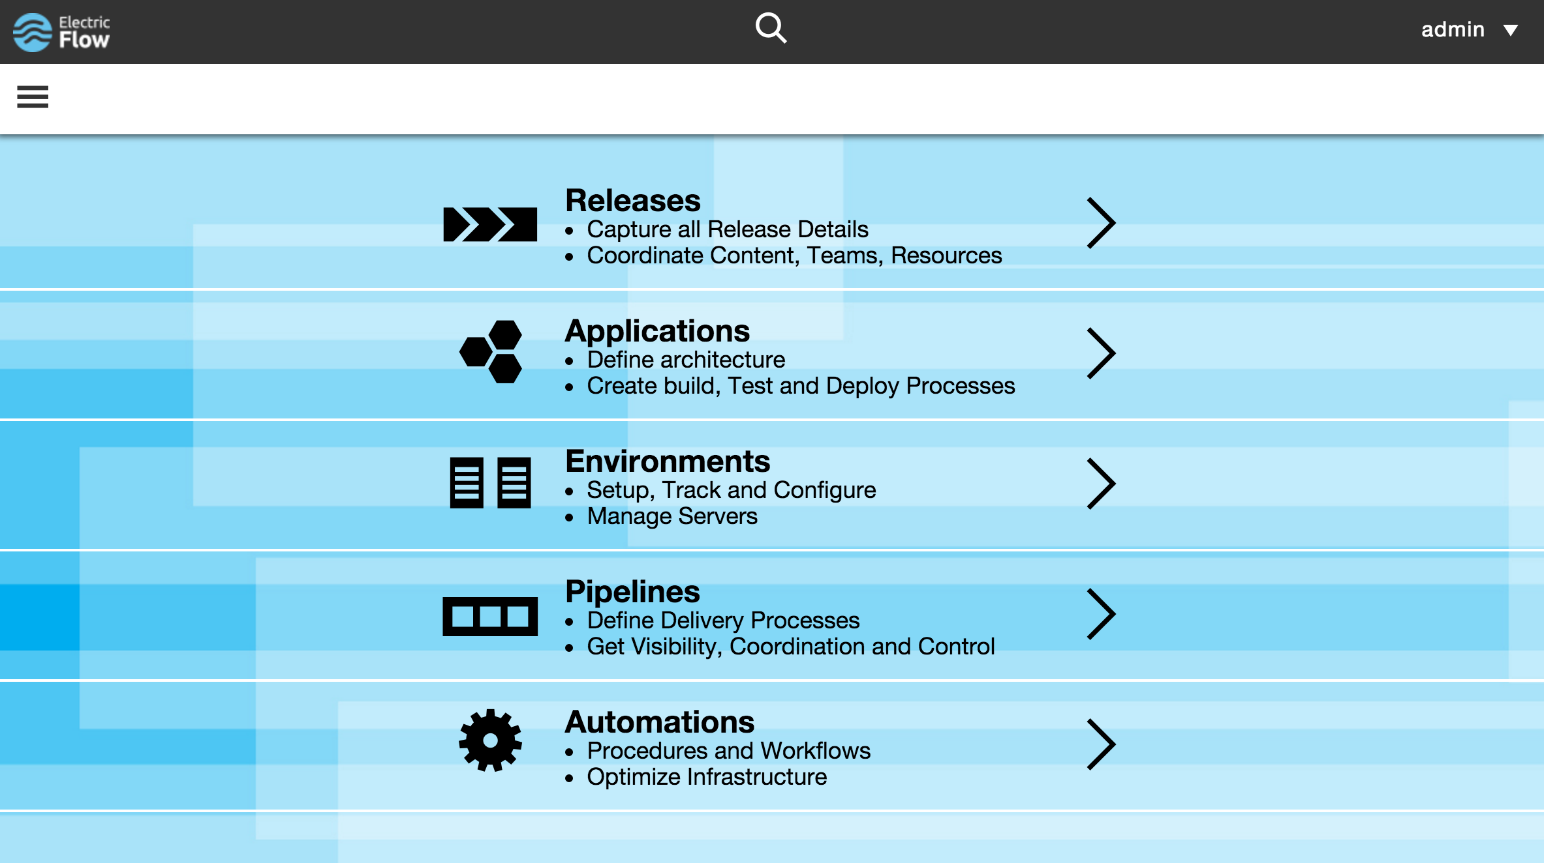
Notes:
Very modern user interface, which is mobile tablet ready.

Slide 13
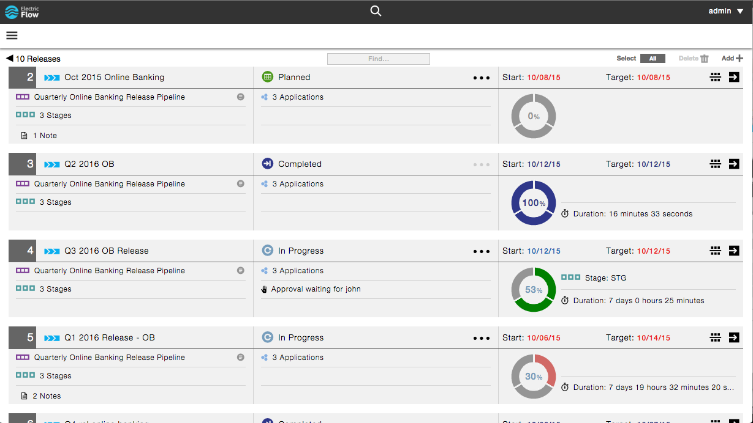
Notes:
Release dashboard provides a birds-eye view of all the releases that are either being planned, in progress, executing or completed. You can easily see the completion status along with key information that tells you if the release is on track.

Slide 14
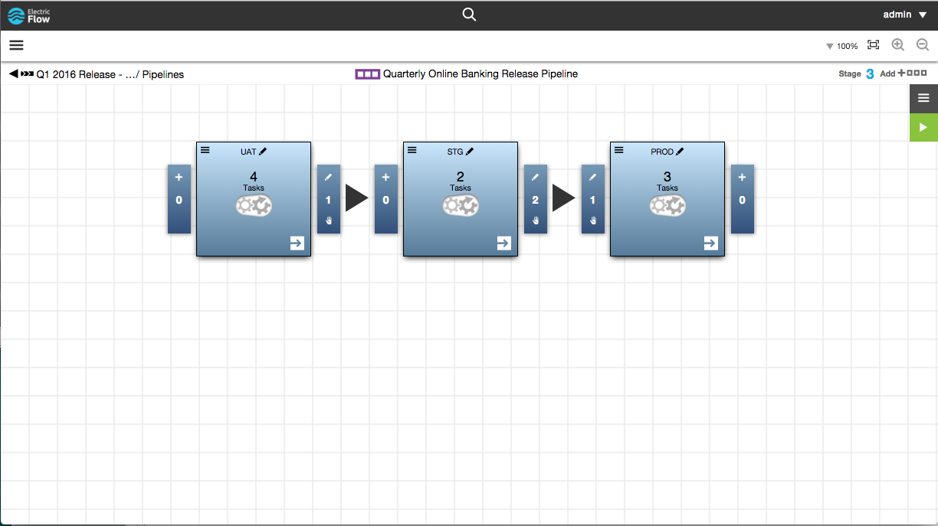
Notes:
The pipeline used for the release process defines all the stages and gates for the release. Gates have both entry and exit criteria which owners approving exiting a stage or prior to entering a stage.

Slide 15
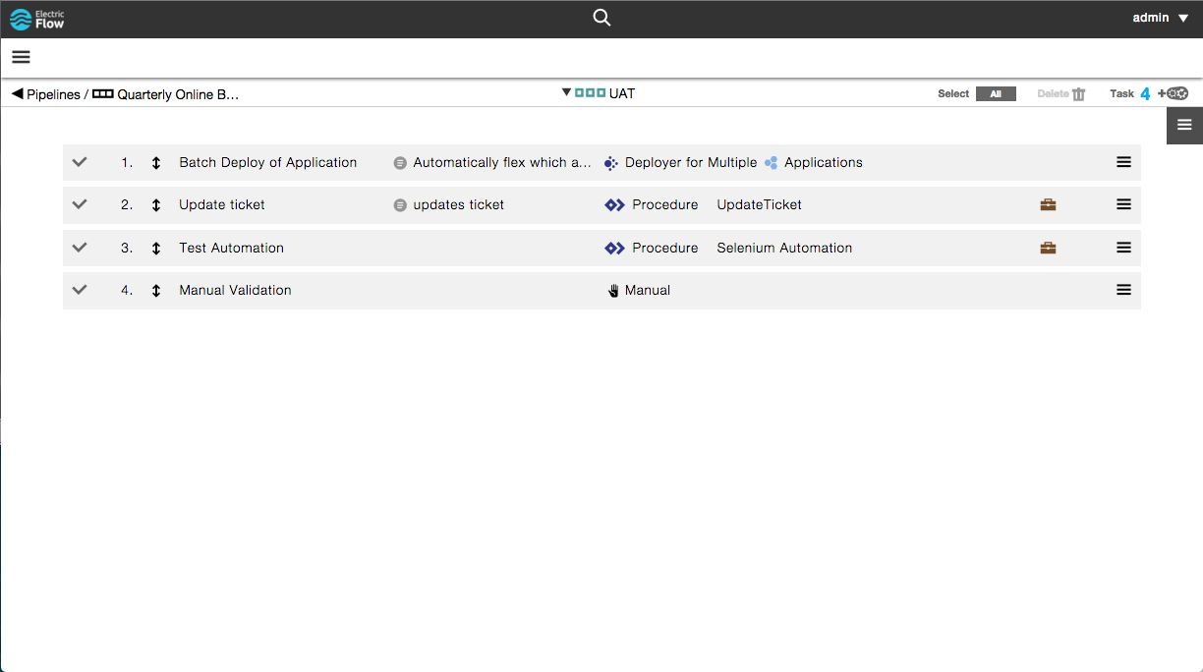
Notes:
Each pipeline stage can have any number of ordered tasks defined, including:
Application processes - for individual deployments
Procedures - for running scripts, etc
Workflows - for more complex logic
Plugins - for 3rd party integrations
Manual – for waiting for human work to be done
Deployer – for defining release batch deployments

Slide 16
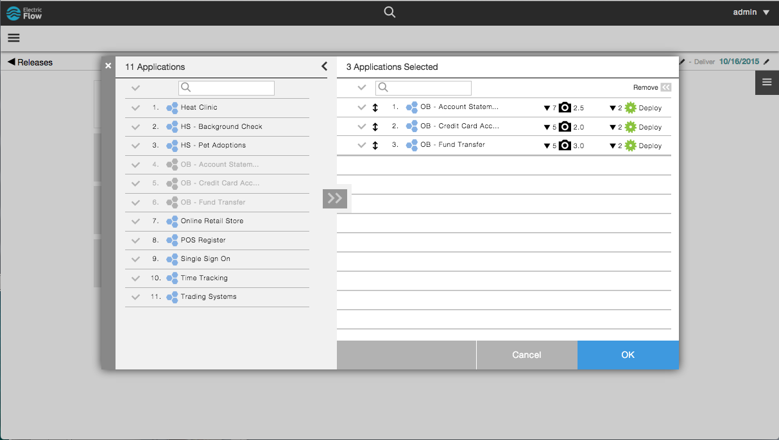
Notes:
Identify the applications that are part of the release (bill of materials). This will become the input to the deployments when running the pipeline.

Slide 17
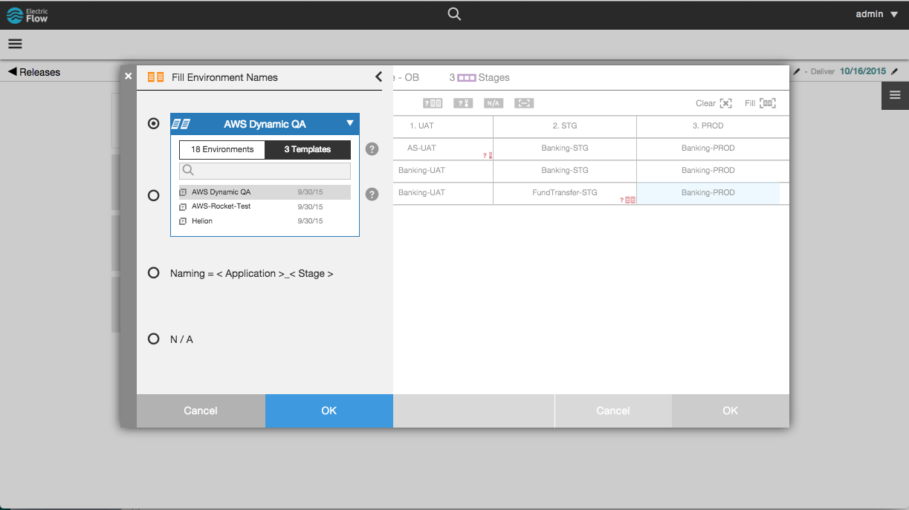
Notes:
Can define the environments that are used by a release. These environments can be statically defined, but they can also be cloud based systems, that are dynamically provisioned on-demand. For example, you could be spinning up a test environment on AWS for testing purposes in the release process.

Slide 18
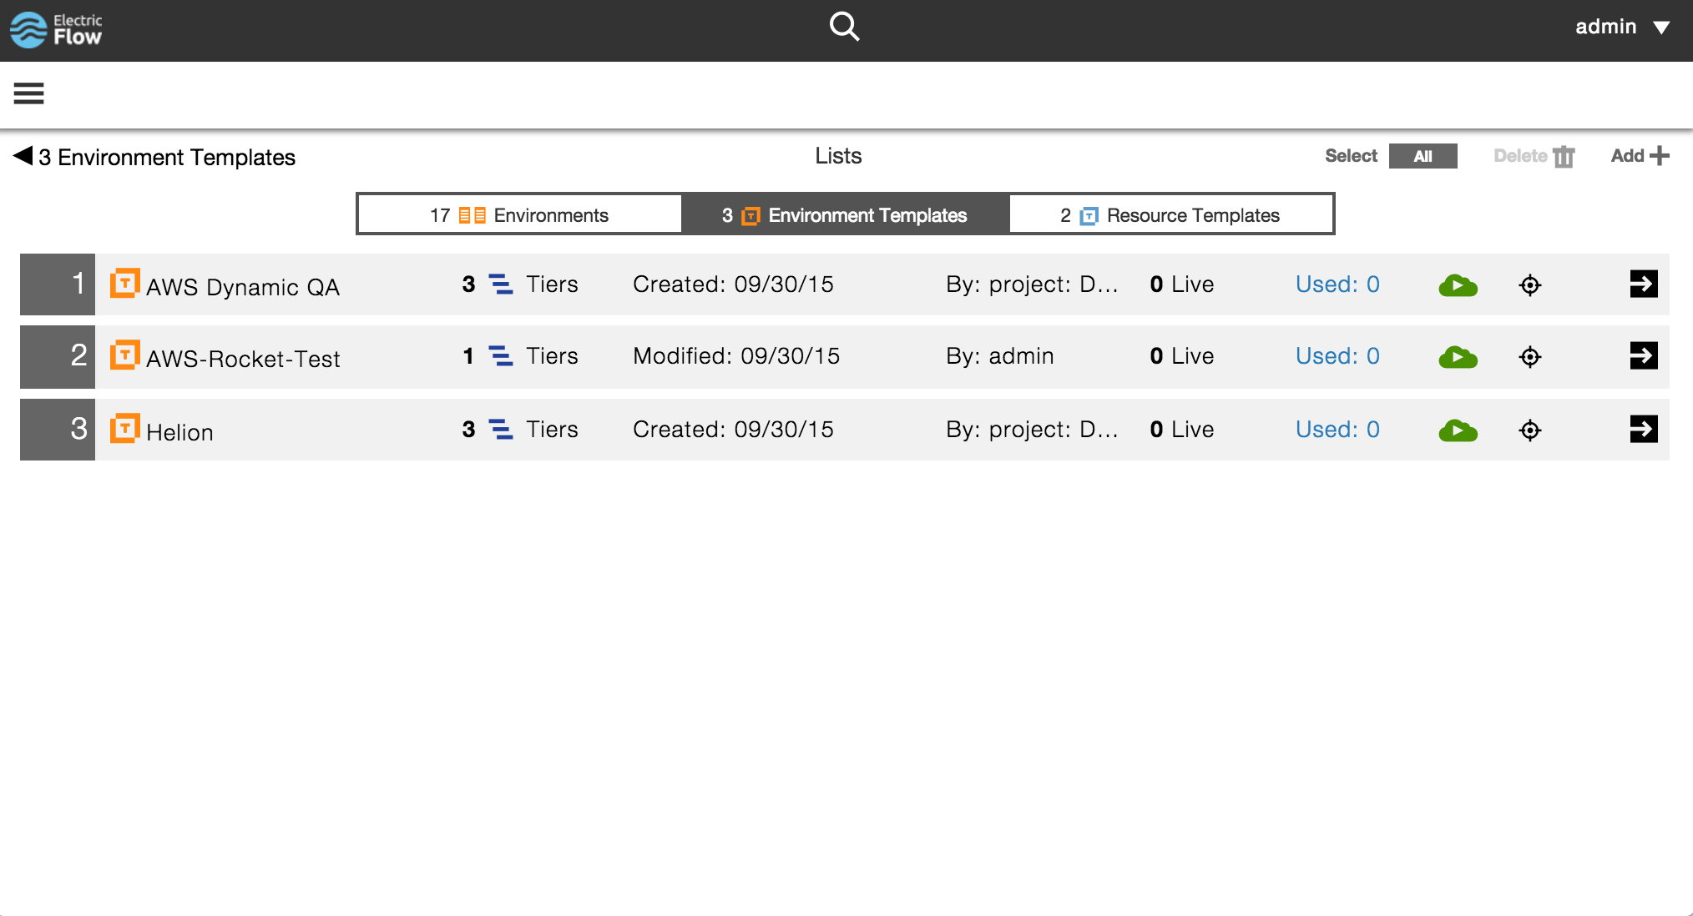
AWS, CHEF
Notes:
The way that works is you can set up environment templates that define all the tiers of the environment.

Slide 19
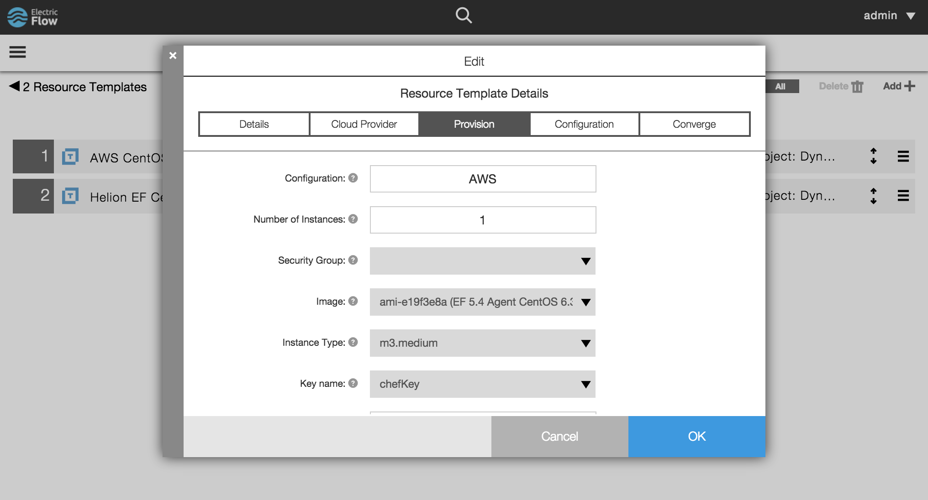
Notes:
For each tier, you can define the type of resources that should be used for that tier. These can be physical resources, or cloud based resources or a combination leading to a hybrid environment. As you define cloud based resources, you can register the provider, type of machine you want to provision as well as configuration and converge steps using Puppet or Chef recipes. So the way this works is when you need an environment, either on an ad-hoc basis or during a deployment, ElectricFlow will provision an instance using the cloud provider and then invoke Chef/Puppet to configure the nodes.
Once all that is done, the application will be deployed onto those servers.

Slide 20
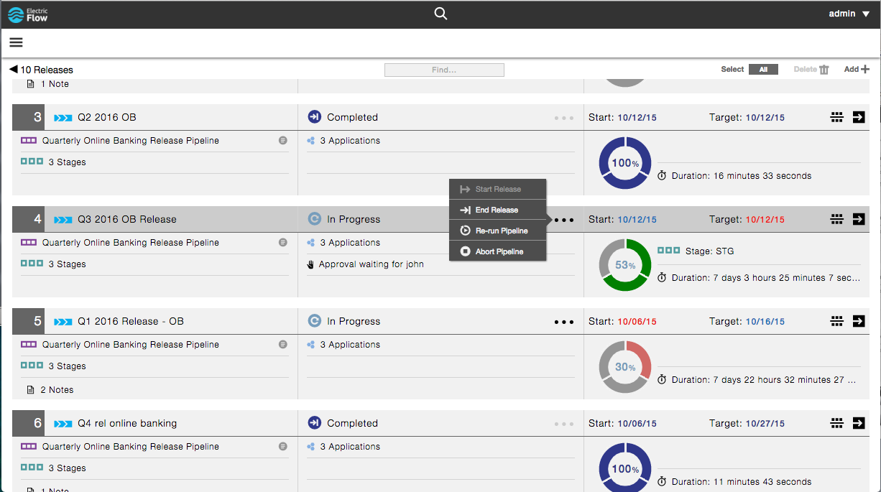
Notes:
Once a release is started, the dashboard becomes the aggregation and control point for restarting, aborting, and accessing any underlying pipelines and their details.

Slide 21
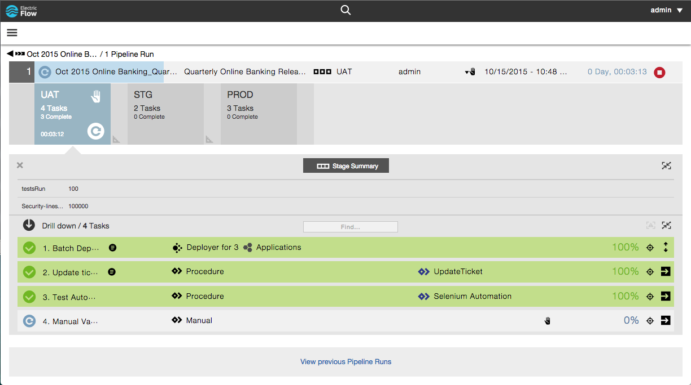
Notes:
You can drill into the pipeline for that release to get a deeper look into the details and status. So in this case I can see that ¾ tasks have finished and that we are waiting on a manual approval.

Slide 22
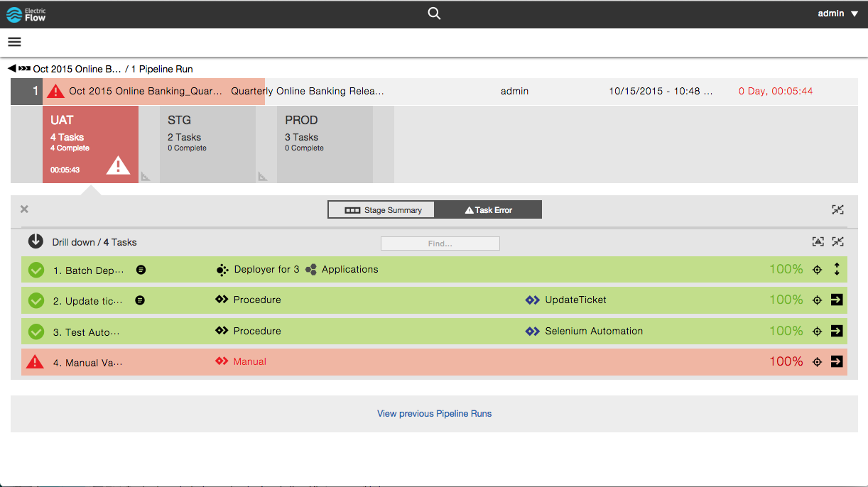
Notes:
Errors or manual rejects fail the pipeline and this gets reflected right away all the way to the very top so you don’t have to hunt around in various jobs.

Slide 23
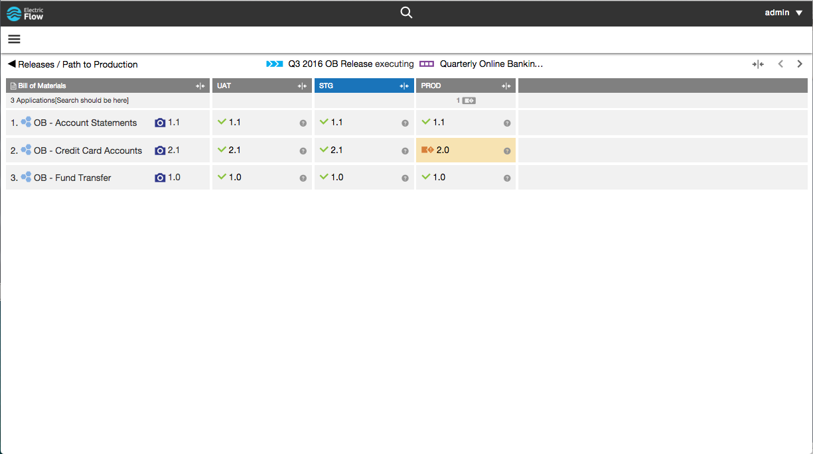
Notes:
A key visibility feature is the path to production view, which shows what is deployed where, throughout the release, and highlights areas that are out of compliance with the release bill of materials.
Shows the application manifest for the release (what should be deployed)
For each stage, shows what is currently deployed.

Slide 24
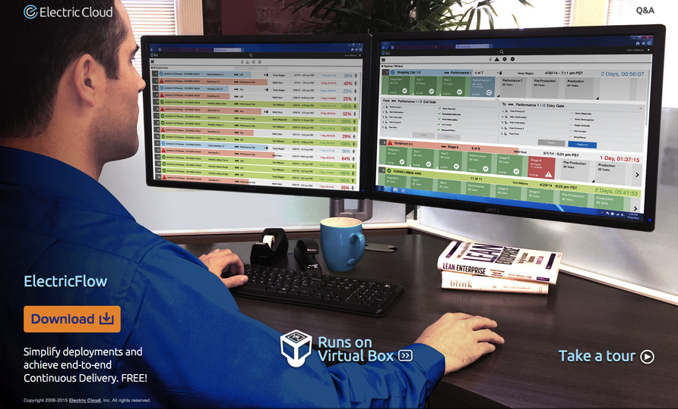
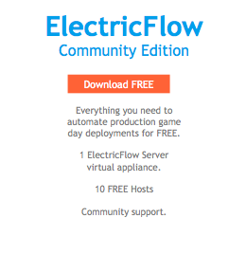

Slide 25
12:03:12
12:03:12

Slide 26
ElectricAccelerator dramatically accelerates software builds and tests by safely parallelizing jobs across shared clusters of physical or cloud CPU’s.

Slide 27
SELENIUM TEST ACCELERATION
7.2x
2 Hosts
Suite of 100 Selenium tests
Selenium tests were not run during continuous integration because the test suite took too long
Before ElectricAccelerator: 27m30s
After: 3m49s using 2 machines

Slide 28
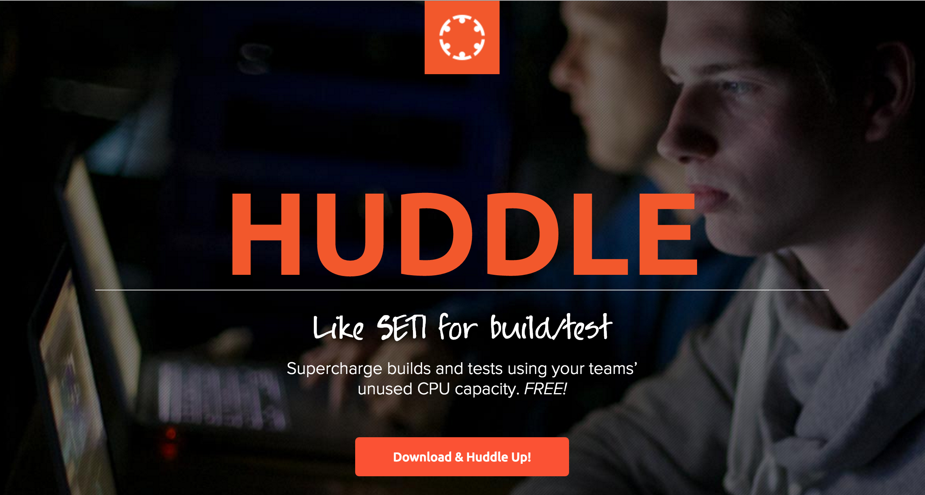
Huddle

Slide 29
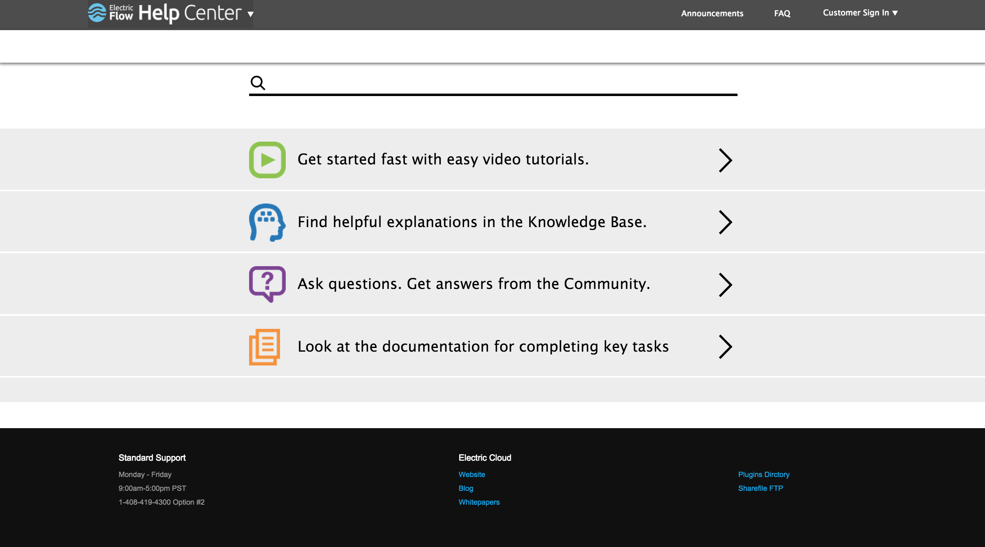
Help Center

Slide 30
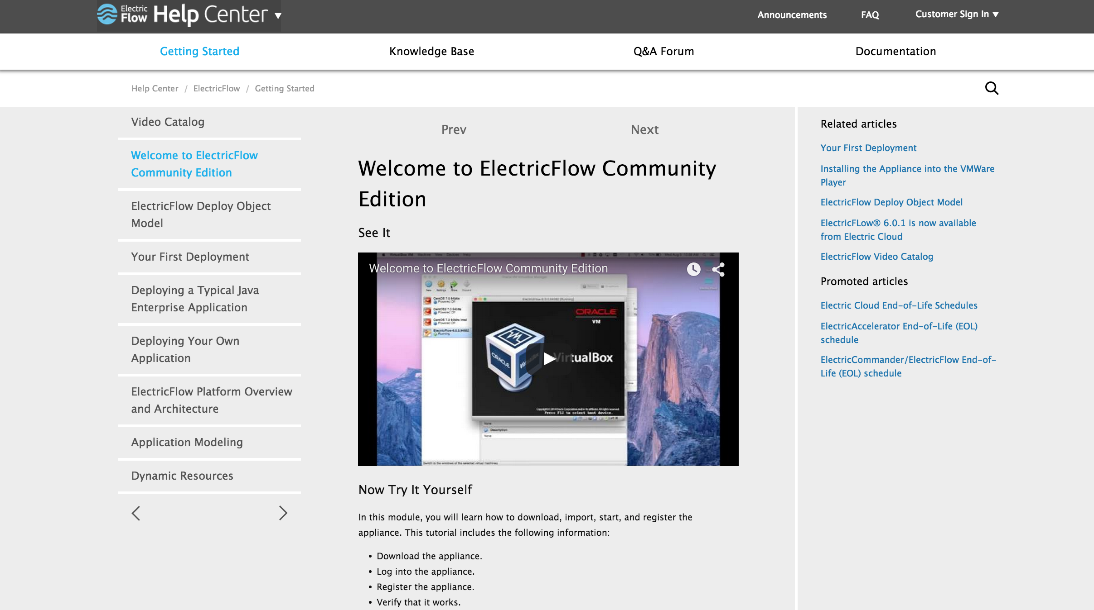

Slide 31

ARA + Configuration Management to Automate Delivery of Applications into Environments
ElectricFlow Release Unifies Traditional Release with CD Pipelines
ElectricAccelerator Reduces Build & Test Cycles
Notes:
To recap, DevOps transformation is a journey, which starts in pockets
Application Release Automation + Configuration Management work together to automate delivery of applications in environments
There are different types of applications with varying rate of change, and so they need different tools and processes to support them
ElectricFlow Release unifies traditional release with CD pipelines
ElectricAccelerator can reduce your build and test cycles

Slide 32
TO LEARN MORE
New to EC?
Wed 1:45P Sam Fell
SeaCliff AB
Want to know about Pipelines & Release?
Tue 11:30A Anand Ahire
SeaCliff AB
Interested in Test Acceleration?
Tue 2:15P Tanay Nagjee
SeaCliff AB
DEMOS IN EXHIBIT HALL
ELECTRICFLOW COMMUNITY DOWNLOAD
HUDDLE DOWNLOAD
Notes:
Lots of great information … if you would like to learn more, we have many opportunities over the next couple of days. We’re also in the exhibit hall as well as both Flow and Accelerator is available as freemium download for you to get started.
THANK YOU!

Slide 33

THANK YOU!

